Slide 1
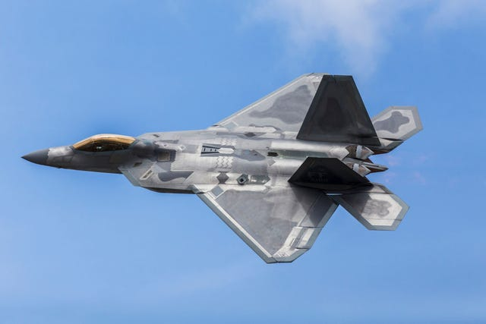
FTG CORPORATION
Aerospace & Defence
Electronic Products & Subsystems
FTG: TSX
October 2026

Slide 2
Disclaimer
This presentation contains certain forward-looking statements. These forward-looking statements are related to, but not limited to, FTG’s operations, anticipated financial performance, business prospects and strategies. Forward-looking information typically contains words such as “anticipate”, “believe”, “expect”, “plan” or similar words suggesting future outcomes. Such statements are based on the current expectations of management of the Company and inherently involve numerous risks and uncertainties, known and unknown, including economic factors and the Company’s industry, generally. The preceding list is not exhaustive of all possible factors. Such forward-looking statements are not guarantees of future performance and actual events and results could differ materially from those expressed or implied by forward-looking statements made by the Company. The reader is cautioned to consider these and other factors carefully when making decisions with respect to the Company and not place undue reliance on forward-looking statements. Other than as may be required by law, FTG disclaims any intention or obligation to update or revise any such forward-looking statements, whether as a result of new information, future events or otherwise.
TSX: FTG

Slide 3
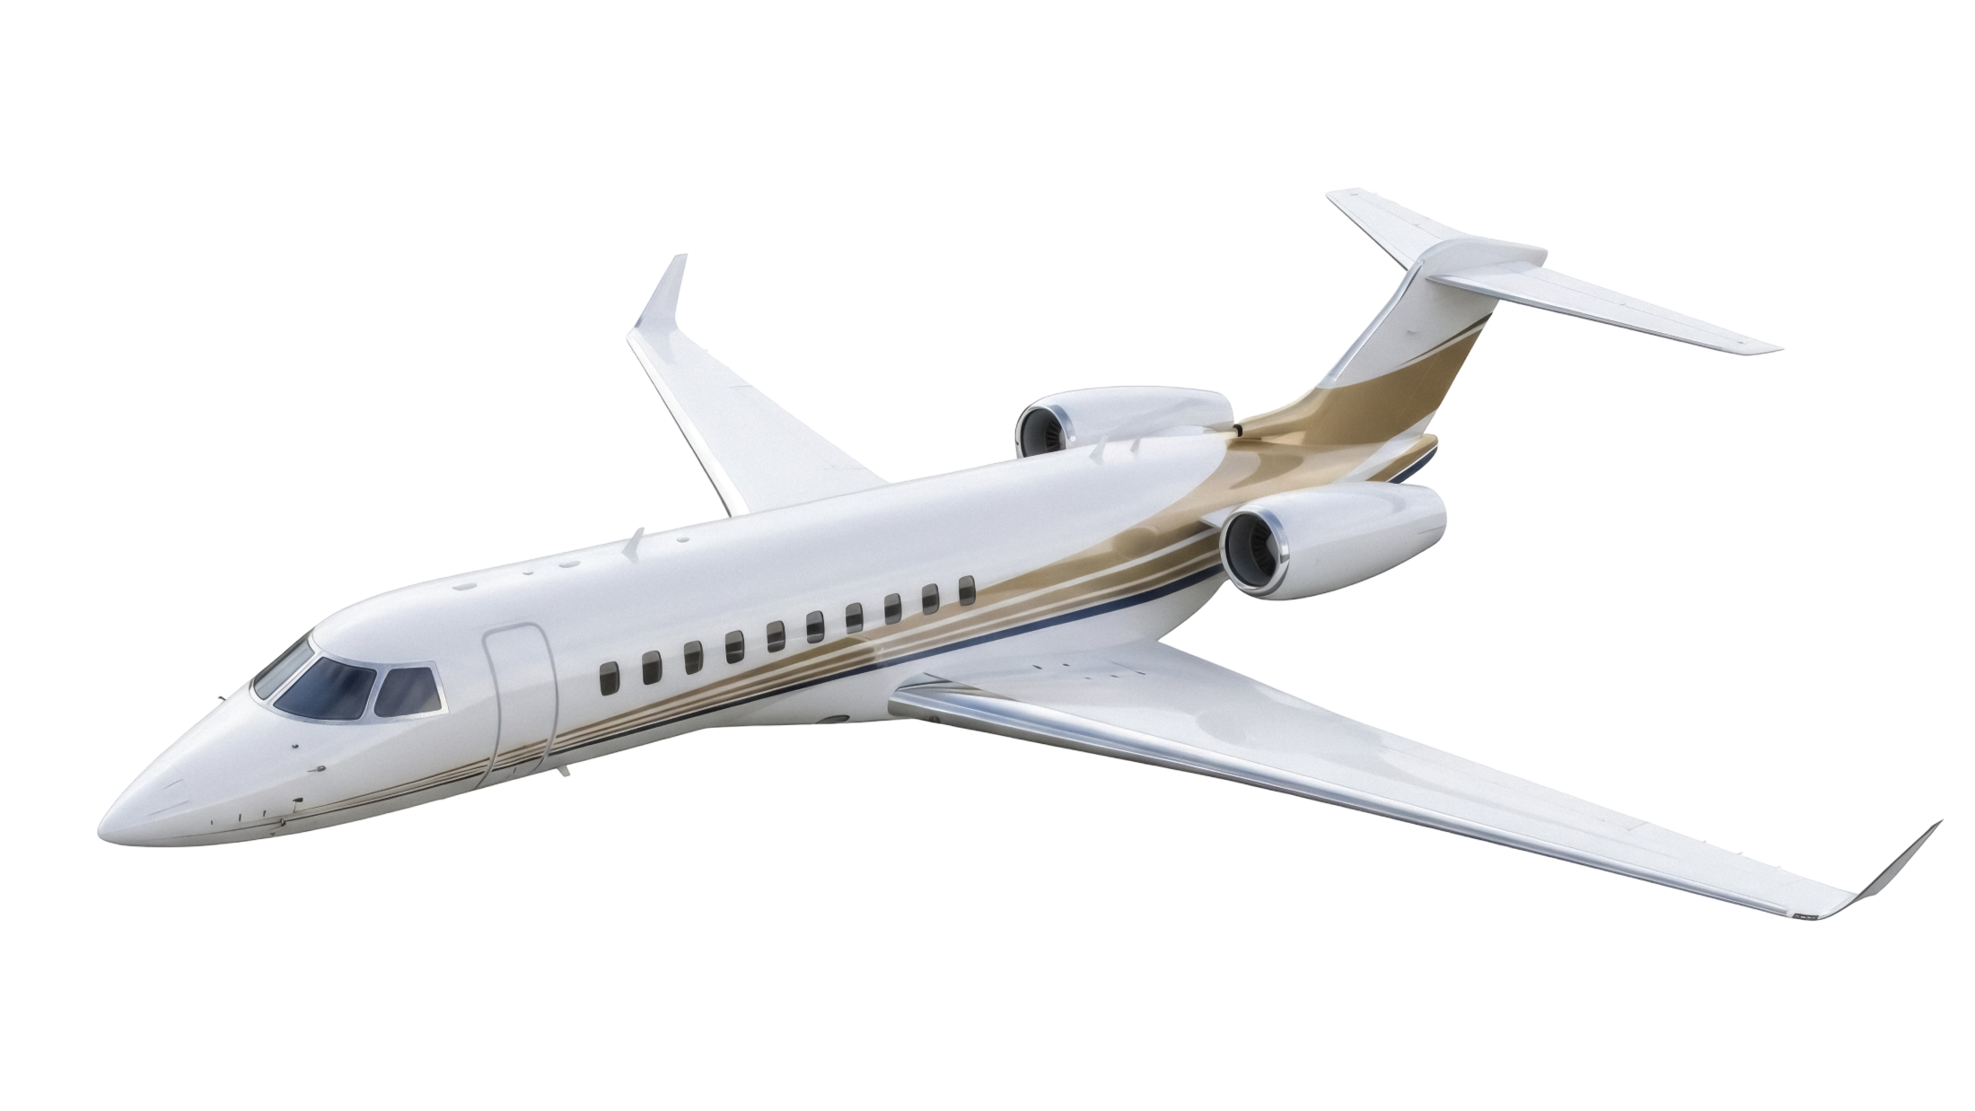
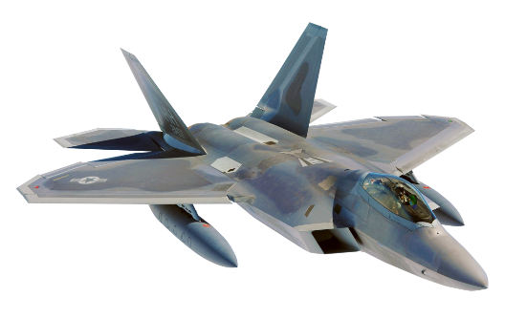
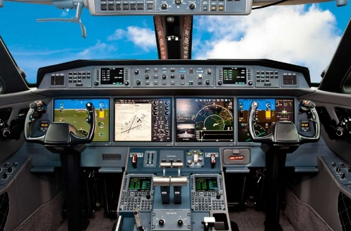
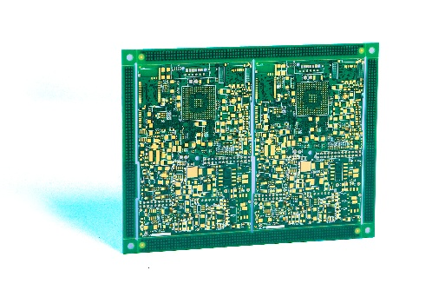
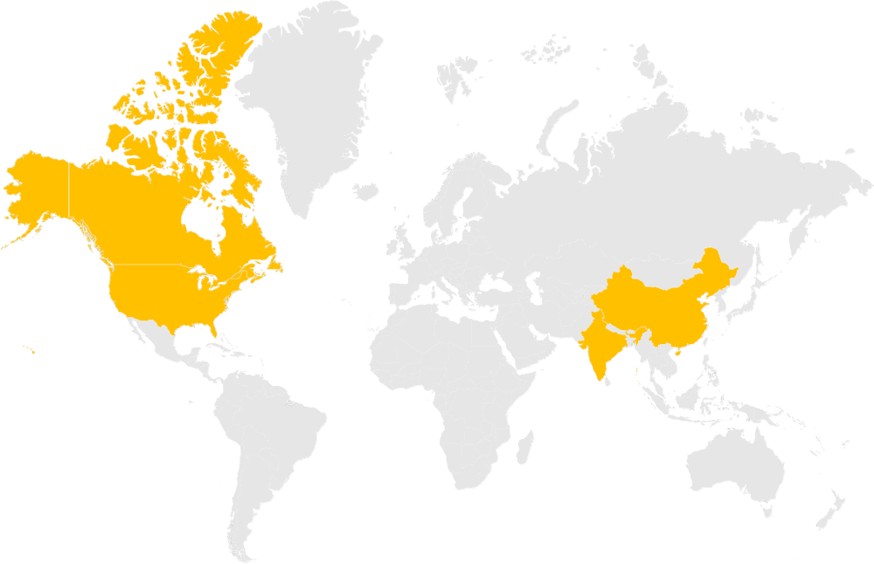

FTG Today: At-A-Glance
$191M
2025
Revenue
$32M
2025
Adj EBITDA
Markets Served
Aerospace & Defence
~25%
Revenue Growth
(4-Year CAGR)
~$148M
2025 Exit
Backlog
Product Portfolio
30+ Years
Length of Relationship with key customers
750+ / 11
Employees / Global Offices
Cockpit and Avionics Products
Printed Circuit Boards
400,000+
Sq. Ft. of Design and Manufacturing Facilities
10
# of Acquisitions or
Greenfield Operations
(Past 15 years)
11 Plants Globally
HQ in Toronto

Slide 4
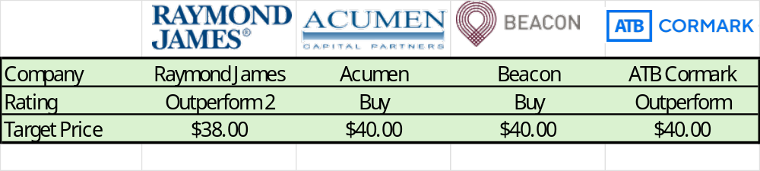
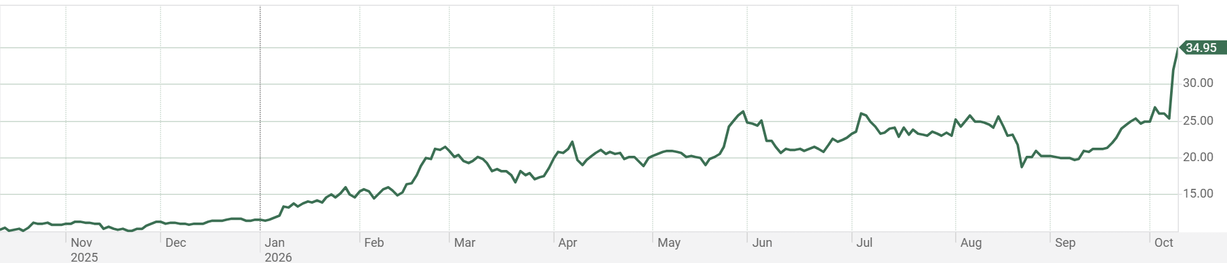
Capital Markets Summary
TSX Stock Symbol:
Fiscal Year End:
Share Price:
Shares Outstanding:
52-Week Range:
Insider Holdings:
Institutional Holdings:
Cash & ST Investments:
Net Cash:
FTG
Nov. 30
$34.95
25.2M
$10.75 - $34.95
~30%
~15%
$12.7M (Q3 26)
$3.9M (Q3 26)
TSX: FTG
Note: All figures in C$ unless otherwise noted.

Slide 5
FTG Scalable Economics
Top Line Drives Bottom Line
CAD/USD Exchange Rate
Variable Cost
~70%
Percent
Fixed Cost
~30%
Contribution Margin of ~30% on incremental revenue
Over 90% of FTG’s revenue denominated in USD
TSX: FTG

Slide 6

FTG Strategic Initiatives
Operating Performance
Deliver Value to Customers
Growth
Reduce Costs, improve Efficiencies
Increase Operating Leverage
Expand Technology, Geography, Capacity
Pursue High Margin Business
Market Positioning
Advanced Technology
  Acquisitions
TSX: FTG
6

Slide 7
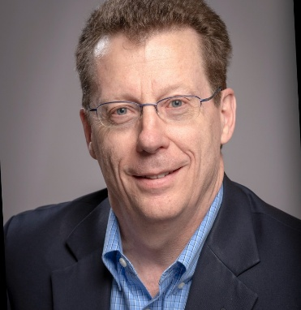
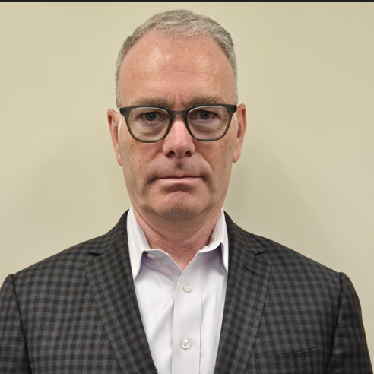
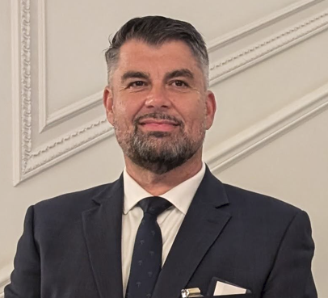


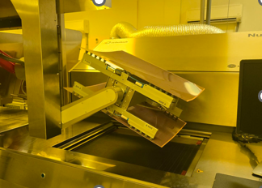
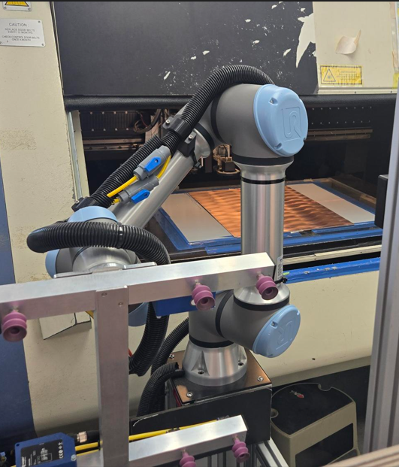
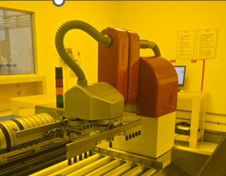
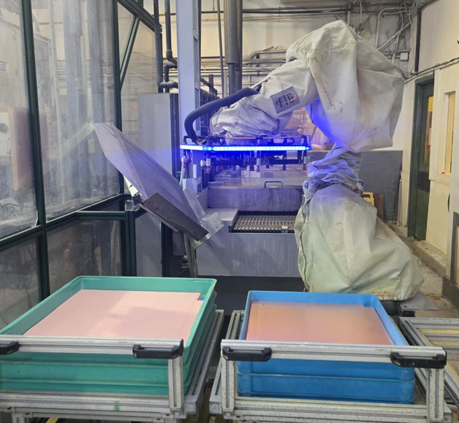
Experienced Leadership Team Driving Performance
Board of Directors
Edward Hanna – Chairman
Brad Bourne – Director
Michael Andrade – Director
Robert Beutel – Director
Christine Forget – Director
Russell David – Director
Brad Bourne
President & CEO
Seasoned Aerospace & Defense leader
Held senior positions with Spar Aerospace Limited
Drew Knight
EVP & CFO
Joined in 2025
25+ years of progressive multinational management experience including Magna Intl., Dexterra Group, and Exco Technologies
Peter Dimopoulos
Vice President Business Dev
Peter was appointed Vice President of Business Development in 2010 after overseeing sales in Canada and China markets
Marko Viinikka
EVP Aerospace
Joined in 2025
Marko brings over 20 years of executive leadership experience, including senior roles in new aircraft development programs for major aerospace OEMs.
Bill Sezate
EVP Circuits
Joined in 2025
Bill has over 20 years of executive experience in manufacturing operations, excelling in sales, quality, engineering, and cost control.

Slide 8
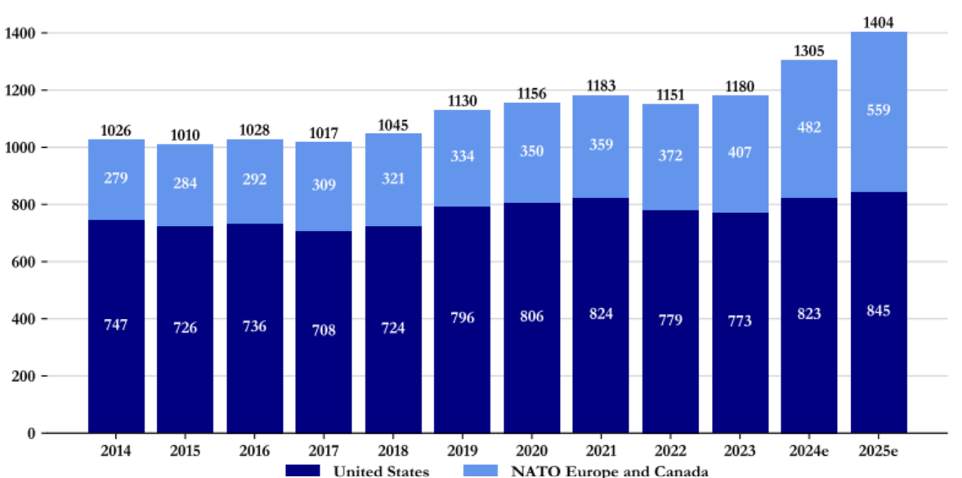
Strong End Market Demand – Commercial and Defence
DEFENCE BUDGETS
Airbus total backlog
9,037
AIRCRAFT
# Aircraft
Boeing total backlog
6,807
AIRCRAFT
Projected
NATO defence spending increased from
37% to 66% of the US spending
Airbus is gaining market share
All sectors are growing
TSX: FTG
Notes:
Highlight the Numbers and Years. Use Boeing Airbus headers.

Slide 9
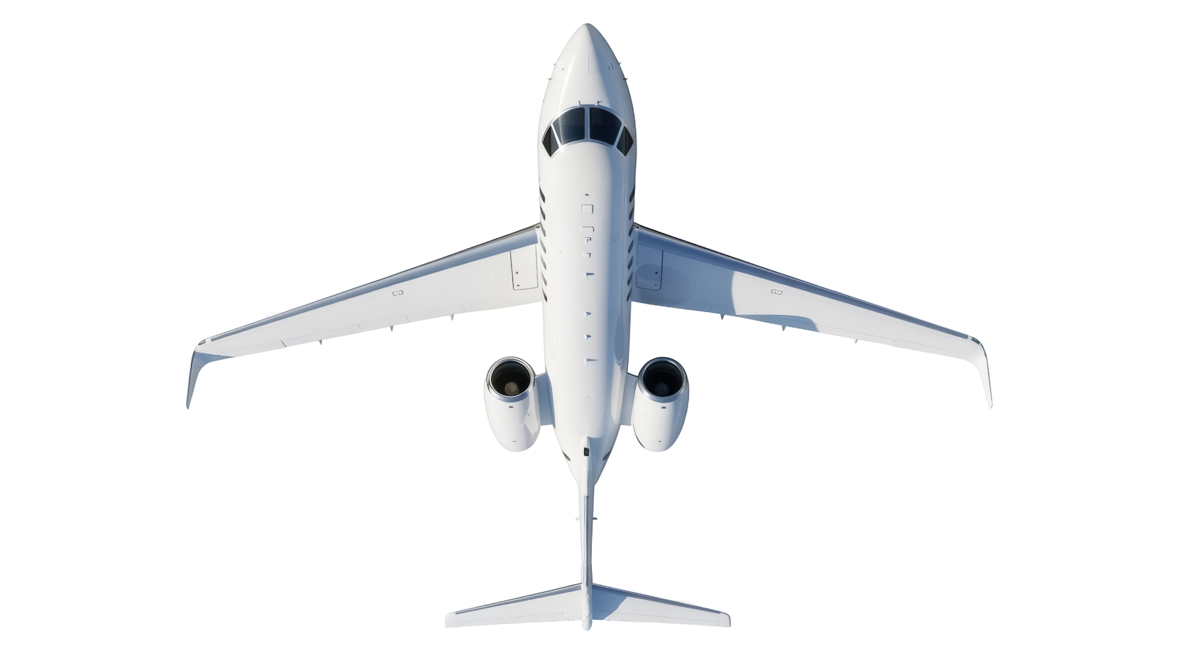
FTG’s Multiple Levers For Continued Growth
TSX: FTG
FTG growth consistently exceeds industry
Suppliers who perform win more work
New program wins, in development phase, are best opportunity to grow market share
Global footprint aligns with Aerospace industry
Acquisitions add capacity, capability, geography
Accretive
Acquisitions
Further Global Expansion
Looking to Europe for either business
7 Acquisitions and 3 greenfield projects in past 15 years
New Programs Wins
Europe
Hyderabad Aerospace – greenfield
Established in Canada, USA and China
Insource Satcom and WQAR production
Weather Radar HMI
Orion Panels
Blue Origin PCBs
Classified Defence Programs (2) PCBs
Blast Exposure Monitoring PCBs
Electronic warfare PCBs
MV-75 PCBs
Operational Performance
Market / Industry
Growth
Provide value to customers
Meet Quality and Delivery expectations of customers
Air Transport growing fast
Defence growing fast
Other segments all growing
TSX: FTG

Slide 10
Barriers to Entry – Drive Margins
Market Positioning– Drive Margins
Technology/Capabilities
Government certifications
After
market
Customer certifications and approvals
Aerospace
Customer Relationships
Margins
Operational Performance
Defence
Financial Strength
Global Footprint
Cash Cycle
Future investment decisions will drive FTG towards higher margin business
TSX: FTG

Slide 11
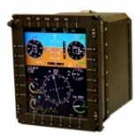
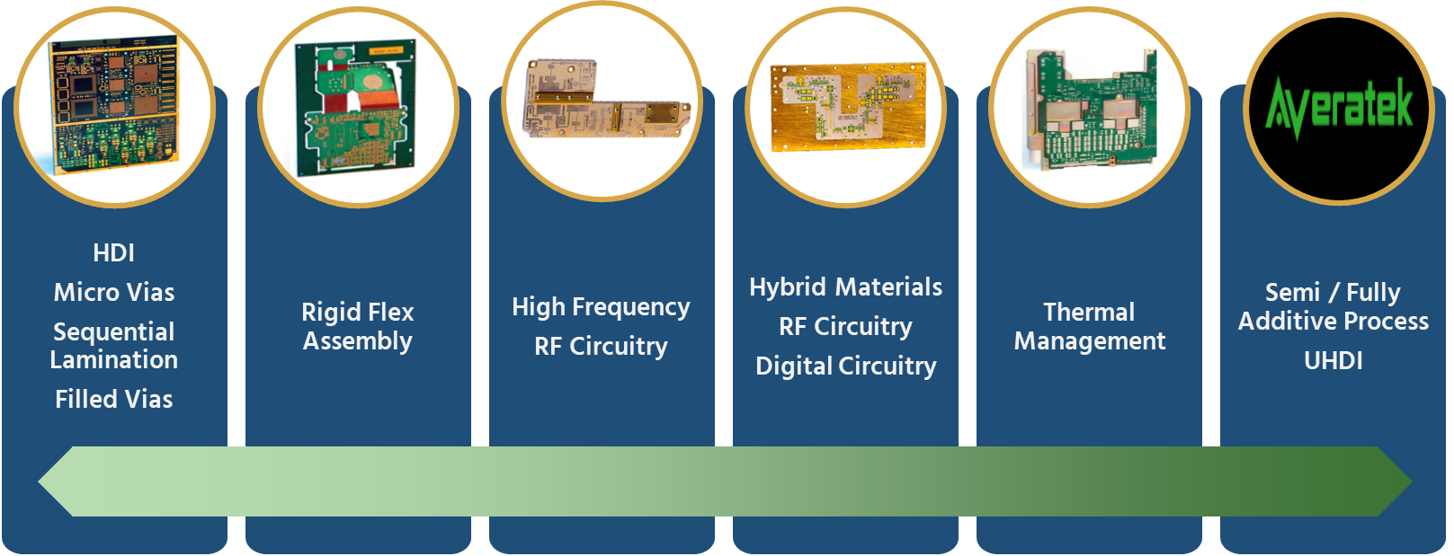
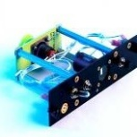
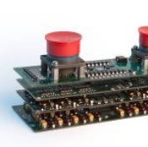
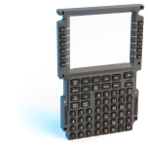

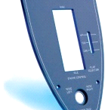
Technology Growth
Aerospace Products
Circuits Products
Electronic Assemblies
Electro Mechanical Assemblies
Power Supplies
Keyboards
Switch Panels
Panels
Offer full range of solutions to simplify customer supply chain
UHDI
Move up value Chain to drive revenue growth
Alignment with customer’s needs – drives growth

Slide 12
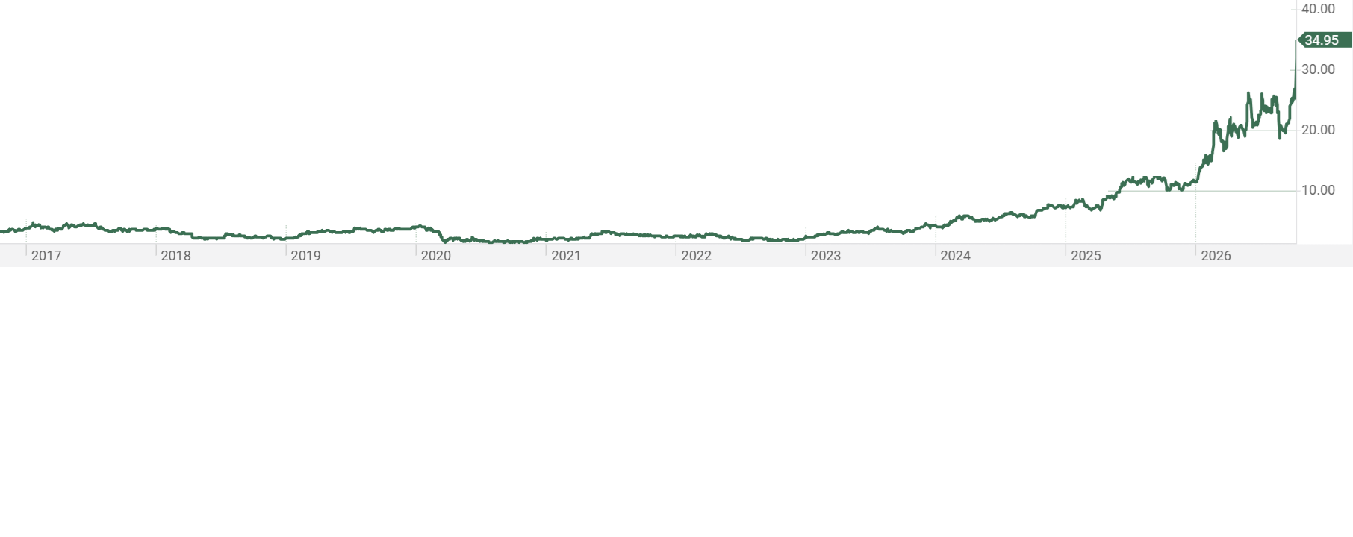
Corporate Development Milestones
FTG Printronics
Circuit - JV
Acquires
Colonial Circuits
Acquires Young
Electronics
FTG Aerospace Chatsworth - Greenfield
FTG Aerospace Hyderabad - Greenfield
Acquires
Teledyne PCT
Acquires
Holaday Circuits
FTG completes reverse takeover
- Becomes public
Acquires Filtran
Micro Circuits
Acquires
IMI Inc
Acquires
Flyht
FTG Aerospace Tianjin - Greenfield
Acquires
Photo Etch
2000-2004
2005-2009
2010-2014
2015-2019
2020-2024
2025-2029
Market focus changed to Aerospace
and Defence
Formed -
FTG Circuits
FTG Aerospace
New technology added to Circuits business
China footprint established for Aerospace business
Increased utilization in USA and other operations
Adds RF technology
Accelerates penetration of the aftermarket, and increases content on Airbus
Adds HDI technology in the USA
Add capacity for
Standard Military Circuits
US footprint established for Aerospace business
India footprint established for Aerospace business (2026)
US footprint established for Circuits business
China footprint established for Circuits business
TSX: FTG

Slide 13
Capital Allocation
Capital allocation plans include:
  Invest organically to ramp throughput and drive technology
  Pursue corporate development opportunities
  Pay down debt
Deploy cash available to improve profitability and shareholder returns
TSX: FTG
Notes:
Capital Allocation 2024 Plans

Slide 14
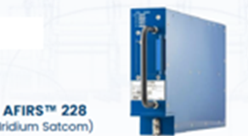
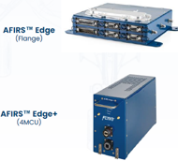
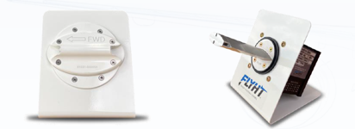
FLYHT (now FTG Aerospace Calgary) Acquisition
Products
Satcom communications via Iridium Satellite system (AFIRS 228)
  Backup aircraft safety communications system
  Aircraft data transmission system for enhanced operations management
  In service for many years, with design update just completed
  Factory option for all Airbus aircraft – via licencing arrangement – 200-300 installed annually
    Licencing revenue to resume in 2026
  Hardware sales and satellite data service sales
Wireless Quick Access Recorder (WQAR) (Edge and Edge +)
  5G wireless connection from aircraft to airline flight operations
  Collect data in flight and transmit aircraft data while at an airport
  Development complete – for two versions
  Hardware sales and wireless service sales
Weather - Water Vapour Sensing System (WVSS II)
  Systems installed on aircraft to collect high altitude weather and water vapour data
  System update complete
  Data sold to National weather agencies such as NOAA
  Hardware and weather data sales
TSX: FTG

Slide 15
FTG Aerospace Calgary Value Creation
TSX: FTG
Reduce costs
Get approvals to sell products on key platforms
Sell 3 existing products
Sell recurring data-related revenue for all 3 products
In source product manufacturing to FTG sites
Shield profits from tax via tax losses
In Source Manufacturing
Shield Profits
Site has over $100M in tax losses
Recurring Sales
Satcom radio to be in-sourced to FTG Chatsworth
WQAR to be in-sourced to FTG Tianjin
Sell Satcom data as Iridium data reseller
Rebuild Satcom licencing revenue
Sell WQAR Wireless data as recurring revenue
Sell weather data as recurring revenue – under existing contracts
Hardware Sales
Sell Satcom Radio globally
Sell 5G WQAR globally
Sell WVSS II to national weather agencies
Explore WVSS for Contrail Avoidance applications
Reduce Costs
Integrating site into FTG benefit plan, and other savings
$1M public company costs eliminated
$3M costs reduced prior to closing
TSX: FTG

Slide 16
Future M&A Considerations
Future Acquisitions
Key criteria for future acquisitions include:
Aligned with FTG market and product focus
Expand technology offering
Expand geographic coverage
  Europe for commercial aerospace
  Europe, India, other top ten countries outside of US for defence
Accelerate FTG’s penetration of the aftermarket segment
Drive up plant utilization
Attractive price, attractive multiple
Accretive to earnings
TSX: FTG

Slide 17
US Tariffs
The US Administration is implementing tariffs on imports into the US
In September 2026 new US tariffs on Canadian imports, included Printed Circuit Boards
  There is an exemption for Civil Aircraft parts
FTG sales include approximately $58M in sales to the US from Canada or China
Mitigation plans include:
  The US-based acquisitions by FTG in 2019 and 2023 have expanded our US manufacturing capacity
  The acquisition of FLYHT in December 2024 reduces our exposure to tariffs as their largest customer is in Canada and they sell globally
  The recent win of cockpit assemblies on the DeHavilland Canadair 515 water bomber will be Canadian revenue generated in our Canadian aerospace site
  The ramp up of the C919 aircraft production in China will create a revenue stream not impacted by US tariffs
  It will take time for the Aerospace and Defence supply chain to move sources of supply so any negative impact to FTG would be felt over time
  We are moving to be more locally focused with US sites selling into US customers and non- US sites selling to non-US customers
  FTG has plans to add sales resources in Canada, Europe and Asia
  FTG’s new facility in Hyderabad India will help open a new non-US market
Input costs are now being impacted by tariffs as much material comes from Asia and ships to or via the USA
  We are working to pass these tariff costs on to customers
TSX: FTG

Slide 18
Financial Highlights – Revenue and Earnings
24% CAGR
29% CAGR
27% CAGR
135% CAGR
TSX: FTG
18

Slide 19
Financial Highlights – Balance Sheet and Investments
Q3
Q3
Q3
Q3
TSX: FTG
Strong working capital and low debt levels – support future investments

Slide 20
ESG at FTG
Focus On Environmental, Social & Governance Factors Across All Operations
Environment: Reduction of impact on the environment in areas such as water recycling, higher efficiency equipment, and committed further investments, with the support of the Canadian and Ontario Governments.
Social: FTG is committed to having a safe, secure and diverse workforce. We proactively review and improve all aspects of safety at our sites.
Governance: Increased board diversity, robust business ethics policies, strong risk management practices.
TSX: FTG
20

Slide 21
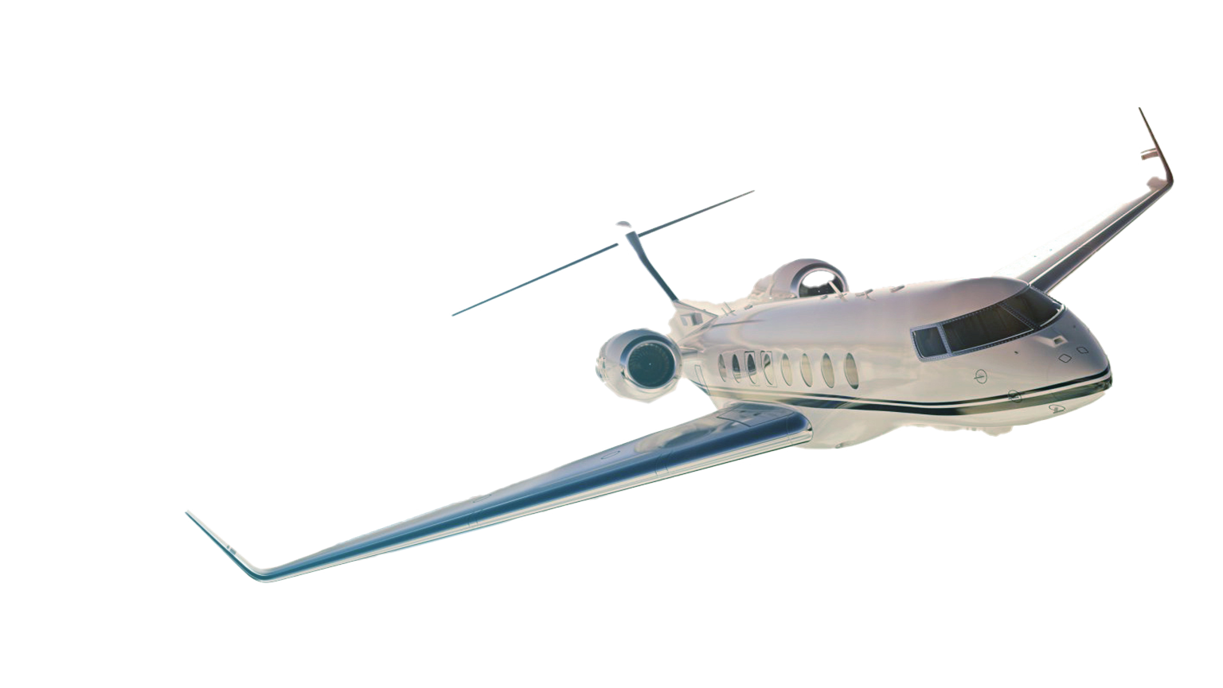

FTG CORPORATION
FTG: TSX

Slide 22
FTG CORPORATION
www.ftgcorp.com | FTG: TSX
FTG: TSX

