Slide 1


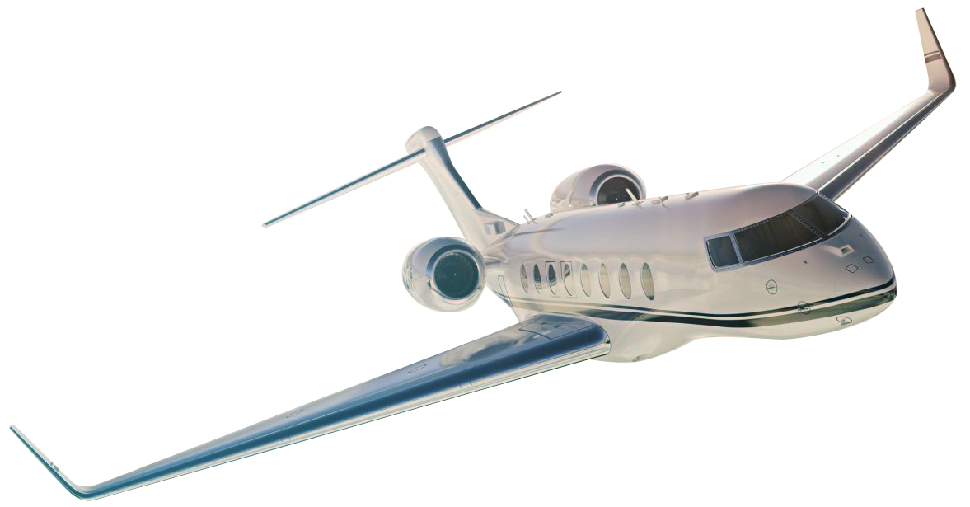

FTG CORPORATION
Aerospace & Defence Electronic Products & Subsystems
FTG: TSX
April 2025

Slide 2
Disclaimer
This presentation contains certain forward-looking statements. These forward-looking statements are related to, but not limited to, FTG’s operations, anticipated financial performance, business prospects and strategies. Forward-looking information typically contains words such as “anticipate”, “believe”, “expect”, “plan” or similar words suggesting future outcomes. Such statements are based on the current expectations of management of the Company and inherently involve numerous risks and uncertainties, known and unknown, including economic factors and the Company’s industry, generally. The preceding list is not exhaustive of all possible factors. Such forward-looking statements are not guarantees of future performance and actual events and results could differ materially from those expressed or implied by forward-looking statements made by the Company. The reader is cautioned to consider these and other factors carefully when making decisions with respect to the Company and not place undue reliance on forward-looking statements. Other than as may be required by law, FTG disclaims any intention or obligation to update or revise any such forward-looking statements, whether as a result of new information, future events or otherwise.
TSX: FTG

Slide 3
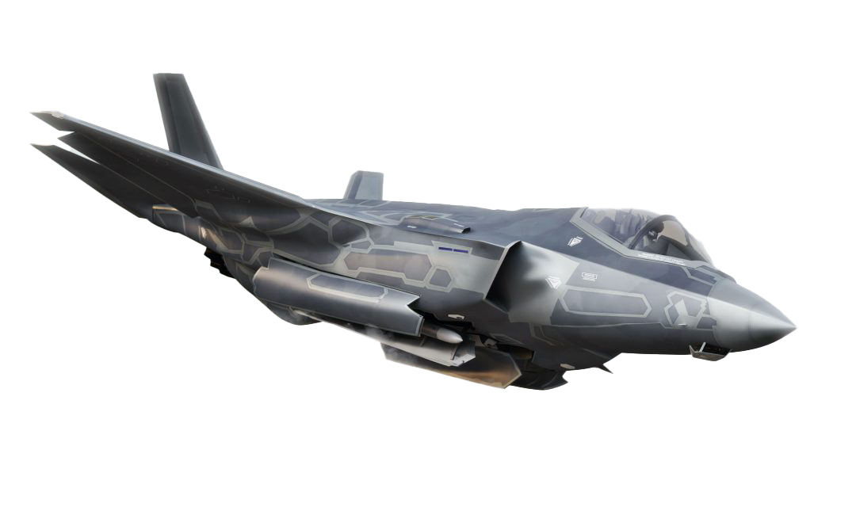


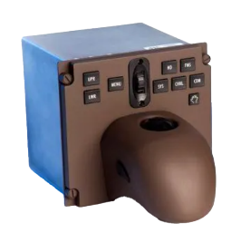
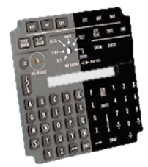
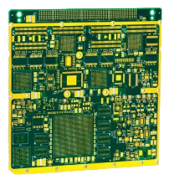
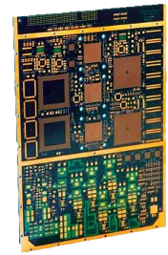
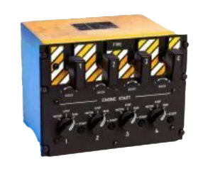
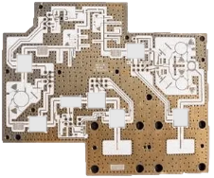
FTG Today: Pioneering Aerospace & Defence Solutions
A Global Force, Crafting Cutting-Edge Electronic Products and Subsystems that Propel the Industry Forward
Markets
Products
Cockpit and Avionics
Products
Printed Circuit Boards
Aerospace & Defence
FTG Aerospace
FTG Circuits
TSX: FTG

Slide 4
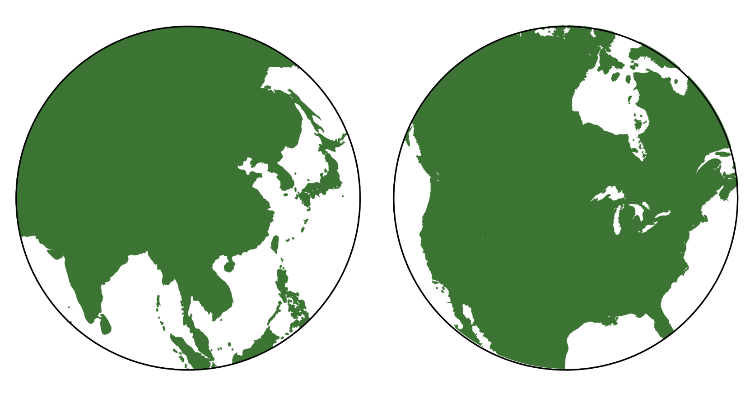


FTG at a Glance
Financial And Operational Snapshot
TSX: FTG
80% Growth in Sales (2022-2024) Driven by Acquisitions & Organic Growth:
​$90M Sales in 2022
​$135M Sales in 2023
$162M Sales in 2024
10 Sites Globally:
​​5 in USA
​3 in Canada
​2 in China
1 site under construction in India
25.2M Common Shares, approximately:
4.8M owned by Oakwest Ltd
2.7M owned by Brad Bourne – CEO
0.5M owned by other Mgmt/Directors
750 Employees Globally
North America
Asia
TSX: FTG

Slide 5


FTG Strategic Initiatives
Operating Performance
Deliver Value to Customers
Reduce Costs, improve Efficiencies
Growth
Increase Operating Leverage
Expand Technology, Geography, Capacity
Pursue High Margin Business
Market Positioning
Advanced Technology
Acquisitions
TSX: FTG
5

Slide 6
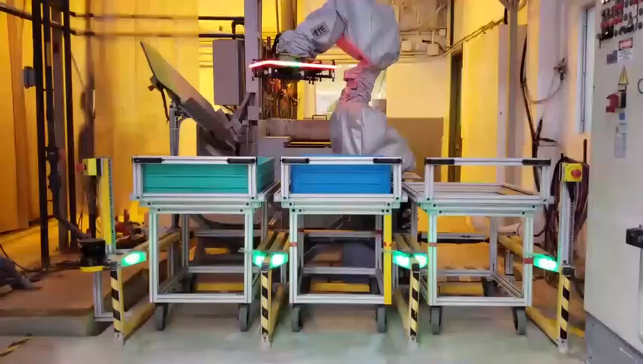
FTG Operating System
Solidifying Leadership Team – Laying The Groundwork To Scale Effectively, Without Compromising Performance
​Build/Strengthen the team
Standardize FTG operating system across the company:
​Leverage best practices from inside and outside FTG
​Ensure consistent performance across all sites
​Ensure standard reporting across the company
Drive Efficiencies
​Understand key metrics
​Streamline processes
​Automate
TSX: FTG
Notes:
Option with video

Slide 7
FTG - Strong Leadership Team
Operational Excellence – Building the team to support future growth and success –with dramatically increased bench-strength
Brad Bourne CEO
CORPORATE LEADERS
OPERATIONS LEADERS
Jamie Crichton
CFO
Peter Dimopoulos
VP Sales
Bill Sezate
EVP Circuits
Marko Viinikka
EVP Aerospace
CORPORATE
(10 STAFF)
SALES
(15 STAFF)
CIRCUITS (455 STAFF)
6 Sites
AEROSPACE (270 STAFF)
4 Sites
1 site under construction
Increased management depth and robust succession options drive to FTG’s long-term success
TSX: FTG
7

Slide 8
FTG - Strong Board Vision and Governance
Governance – Ensuring a balance of knowledge, experience and fresh perspectives
202
2025 Board Nominees
Ed Hanna Chairman
Audit Committee Chair
Board member since 2002
Defence Industry Experience
38K shares
Robert Beutel
Board Member
Mike Andrade
Board Member
Christine Forget
Board Member
Brad Bourne
Board Member
Board member since 2021
Investment Management Experience
4.9M shares
Compensation Committee Chair
Electronics Industry Experience
Board member since 2015
115K shares
20 years at Bombardier.
Other technology company experience.
Nominated for election for 2025
FTG President and CEO
Board member since 2002
2.75 M shares

Slide 9
FTG - Strong Board Vision and Governance
Governance – Ensuring a balance of knowledge, experience and fresh perspectives
FTG has implemented a rigorous and structured approach to Board composition
Skills/gap assessment
Inputs from shareholders
Succession plans
Term limits
Board mandate is updated accordingly
FTG has replaced DSU compensation for Directors
Replaced with targets for shareholding of FTG shares

Slide 10
FTG Strategic Initiatives
Operating Performance
Deliver Value to Customers
Growth
Increase Operating Leverage
Reduce Costs, Improve Efficiencies
Expand Technology, Geography, Capacity
Pursue High Margin Business
Market Positioning
Advanced Technology
Acquisitions
TSX: FTG
10

Slide 11
FTG Scalable Economics
Top Line Drives Bottom Line
CAD/USD Exchange Rate
Variable Cost
~70%
Percent
Fixed Cost
~30%
Contribution Margin of ~30% on incremental revenue
Over 90% of FTG’s revenue denominated in USD
TSX: FTG

Slide 12
Commercial Aircraft Deliveries
​Airbus
Airbus total backlog
8,658
​Airbus shipped double Boeing’s shipments in 2024
Airbus expected to approach 2019 shipments levels in 2025
AIRCRAFT
# Aircraft
Boeing total backlog
5,595
​Boeing
Boeing impacted by Alaska Air incident in 2024, and a strike
New CEO at Boeing refocusing the company on its core business
AIRCRAFT
Projected
Airbus is outperforming Boeing in the next few years
TSX: FTG
Notes:
Highlight the Numbers and Years. Use Boeing Airbus headers.

Slide 13
US Defence Spending
US DEFENCE SPENDING
Recent
Trump/Hegseth
DoD budget
request for
next year
$B
Defence spending is increasing as geopolitical tensions increase around the globe
TSX: FTG
13

Slide 14







FTG’s Multiple Levers For Continued Growth
4.
New Technology
Increase product offerings to grow content per aircraft
2.
New Programs
Win content on new programs in development
3.
Operational Excellence
Quality, delivery, customer service
6.
Acquisitions
In support of increased capacity, add technology, add geographic region
1.
Market/ Industry Growth
Growth in the industry
5.
Globalization
Offer Canada, USA and China solutions
TSX: FTG
14

Slide 15
FTG Strategic Initiatives
Operating Performance
Deliver Value to Customers
Increase Operating Leverage
Growth
Reduce Costs, Improve Efficiencies
Expand Technology, Geography, Capacity
Pursue High Margin Business
Market Positioning
Advanced Technology
Acquisitions
TSX: FTG
15

Slide 16






Barriers to Entry
Technology/Capabilities
Government certifications
Customer certifications and approvals
Customer Relationships
Operational Performance
Financial Strength
Global Footprint
TSX: FTG
16

Slide 17

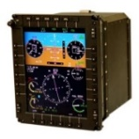
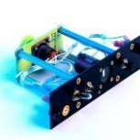
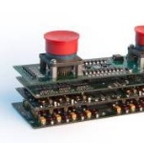
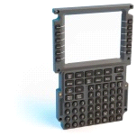

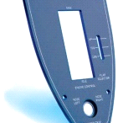
Aerospace Technology Growth
Technology Growth Drives Higher Content Per Aircraft And Accelerates Revenue Growth
Electronic Assembly
Power Supply
45%
Switch Panel
Panel
of 2024 sales are assemblies
Electro-mech Assembly
Keyboard
TSX: FTG
17

Slide 18
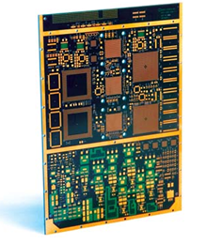
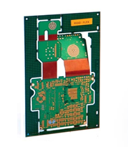
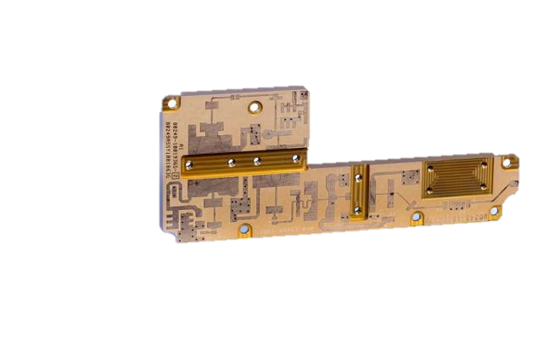
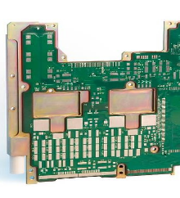

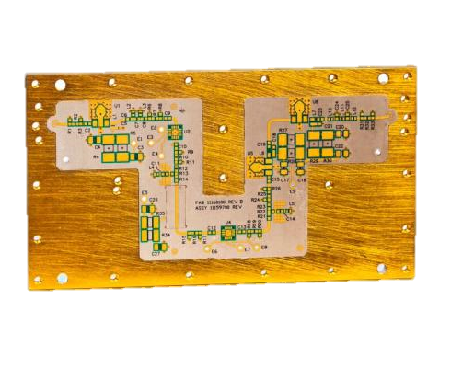
Circuits – Technology Growth
HDI
Micro Vias
Sequential Lamination
Filled Vias
Rigid Flex Assembly
High Frequency
RF Circuitry
Hybrid Materials
RF Circuitry
Digital Circuitry
Thermal Management
Semi / Fully Additive Process (Averatek)
UHDI
Over 50% of sales are high technology or specialty products
TSX: FTG
Notes:
Add in slide 17. Circuit chart

Slide 19
Market Positioning
Benchmarking Process Used To Assess Financial Attractiveness Of Various Market Segments
After
market
Simulators
Aerospace
Margins
Defence
Cash Cycle
Future investment decisions will drive FTG towards higher margin business
TSX: FTG
19

Slide 20
FTG Strategic Initiatives
Operating Performance
Deliver Value to Customers
Growth
Reduce Costs, Improve Efficiencies
Increase Operating Leverage
Pursue High Margin Business
Expand Technology, Geography, Capacity
Market Positioning
Advanced Technology
Acquisitions
TSX: FTG
20

Slide 21
Corporate Development Milestones
Company Founded Helix Circuits
Acquires Filtran Micro Circuits
Acquires Photo Etch
Company renamed Circuit World
Incorporates FTG Aerospace Tianjin
Acquires Teledyne PCT
Acquires Colonial Circuits
FTG completes reverse takeover
FTG Aerospace Chatsworth Grand Opening
Acquires IMI
Acquires Young Electronics
FTG Printronics Circuit formed
Acquires Holaday
Acquires Flyht
1983
1995
2003
2004
2008
2010
2012
2013
2014
2015
2016
2019
2023
2024
Commercial PCB
Manufacturer
Market focus changed to Aerospace
and Defence
Two business units formed -
FTG Circuits
FTG Aerospace
US footprint established for Circuits business
New customers & technology added
China footprint established for Aerospace business
US footprint established for Aerospace business
Increased utilization in USA and other operations
Adds RF technology
Adds HDI technology in the USA
Accelerates penetration of the aftermarket, and increases content on Airbus
New technology added to Circuits business
China footprint established for Circuits business
Add capacity for
Standard Military Circuits
TSX: FTG

Slide 22
FLYHT Acquisition
Deal closed December 20, 2024
Enterprise value of approximately $23M
~$13.7M in equity and assumption of debt (debenture and Government debt)
Approximately $20M in sales
Nearing completion of 3 new/updated aftermarket products
Key Strategic Benefits
Increase FTG’s penetration of the Commercial Aerospace Aftermarket
High margin business
Increase FTG’s content on Airbus aircraft
Airbus is the leading performer in the Air Transport market
First Avionics products for FTG
Next step up in technology
Insource manufacturing of FLYHT products to FTG sites
Capture manufacturing margin in house

Slide 23
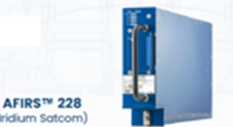
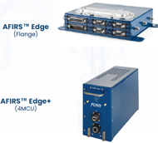
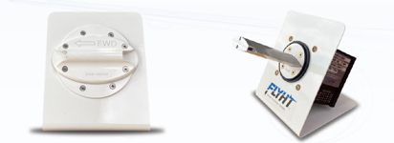
FLYHT Acquisition
Products
Satcom communications via Iridium Satellite system (AFIRS 228)
Backup aircraft safety communications system
Aircraft data transmission system for enhanced operations management
In service for many years, with design update just completed
Factory option for all Airbus aircraft – via licencing arrangement – 200-300 installed annually
Licencing revenue to resume in 2026
Hardware sales and satellite data service sales
Wireless Quick Access Recorder (WQAR) (Edge and Edge +)
5G wireless connection from aircraft to airline flight operations
Collect data in flight and transmit aircraft data while at an airport
Development just completing – for two versions
Hardware sales and wireless service sales
Weather - Water Vapour Sensing System (WVSS II)
Systems installed on aircraft to collect high altitude weather and water vapour data
System update nearing completion
Data sold to National weather agencies such as NOAA and UK Met
Hardware and weather data sales

Slide 24
FLYHT Acquisition
Path Forward
Reduce operating costs
Reduce internal costs - FLYHT restructured in September 2024 significantly reducing labour costs
Product development efforts winding down
Eliminate public company costs
Total savings estimated at ~$4M annually
Aggressively sell all products against existing Supplemental Type Certificates (STCs)
STCs are required government approvals (Transport Canada, FAA, EASA, CAAC) to install equipment on specific aircraft types in their jurisdiction
Satcom product has wide range of STCs
New product priority STCs are Boeing 737 and Airbus A320 variants for the EDGE products
Pursue new STCs for additional aircraft types and countries
In-source product manufacturing to FTG site(s)
Shield future profits with existing tax losses at FLYHT

Slide 25
Future M&A Considerations
Future Acquisitions
Key criteria for future acquisitions include:
Aligned with FTG market and product focus
Expand technology offering
Expand geographic coverage
Europe for commercial airspace
Europe, India, other top ten countries outside of US for defence
Accelerate FTG’s penetration of the aftermarket segment
Drive up plant utilization
Attractive price, attractive multiple
Accretive to earnings
TSX: FTG

Slide 26
Capital Allocation
Capital allocation plans include:
Invest organically to ramp throughput and drive technology
Pursue corporate development opportunities
We have an NCIB to buy back up to 5% of outstanding shareholder stock
616,400 shares repurchased since 2022
Deploy cash available to improve profitability and shareholder returns
TSX: FTG
Notes:
Capital Allocation 2024 Plans

Slide 27
US Tariffs
The new US Administration is implementing tariffs on imports into the US
FTG sales include approximately $55M in sales to the US from Canada or China
Mitigation plans include:
It will take time for the Aerospace and Defence supply chain to move sources of supply so any negative impact to FTG would be felt over time
The US-based acquisitions by FTG in 2023 have expanded our US manufacturing capacity The acquisition of FLYHT in December 2024 reduce our exposure to tariffs as their largest customer is in Canada and they sell globally
We are moving to be more locally focused with US sites selling into US customers and non- US sites selling to non-US customers
FTG’s is focusing on growing content with Airbus that will reduce focus on the US market
FTG is developing plans to add sales resources in Canada, Europe and Asia
The recent win of cockpit assemblies on the DeHavilland Canadair 515 water bomber will be Canadian revenue generated in our Canadian aerospace site
FTG’s plans to open a facility in Hyderabad India will help open a new non-US market
Today our Canadian sites are least impacted by US Tariffs
No tariffs on input costs
No tariffs on shipments to US customers

Slide 28
Financial Highlights – By Quarter
ADJ EBITDA
$K
Revenue
$K
Revenue has more than doubled since pandemic lows
TSX: FTG

Slide 29
Balance Sheet Highlights
Working Capital
$M
Net Cash/Debt
Working Capital | Working capital remains strong after the acquisitions
Net Cash | FTG has minimal debt after completing two acquisitions in 2023 and one in 2024
TSX: FTG

Slide 30
Cash Flow Highlights
$K
Cash conversion above 100% every year except 2023/24. 2023/24 cash conversion impacted by large ramp in production
Q1 2025 cash conversion near 300% of net income
(1) Cashflow excludes acquisition costs and building purchase/sale.
TSX: FTG

Slide 31
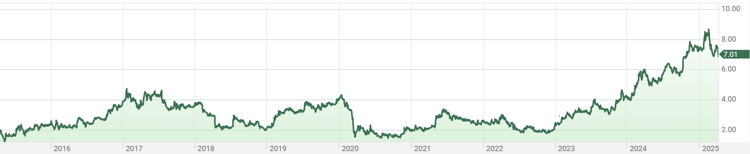
FTG’s Stock Performance
Stock is up about 300% in the last decade FTG TTM EV/EBITDA is ~6.6X at Q1 2025
FTG now trades on the OTCQX market in the US – ticker FTGFF
TSX: FTG

Slide 32


ESG at FTG
Focus On Environmental, Social & Governance Factors Across All Operations
Environment: Reduction of impact on the environment in areas such as water recycling, higher efficiency equipment, and committed further investments, with the support of the Canadian and Ontario Governments.
Social: FTG is committed to having a safe, secure and diverse workforce. We proactively review and improve all aspects of safety at our sites.
Governance: Increased board diversity, robust business ethics policies, strong risk management practices.
TSX: FTG

Slide 33
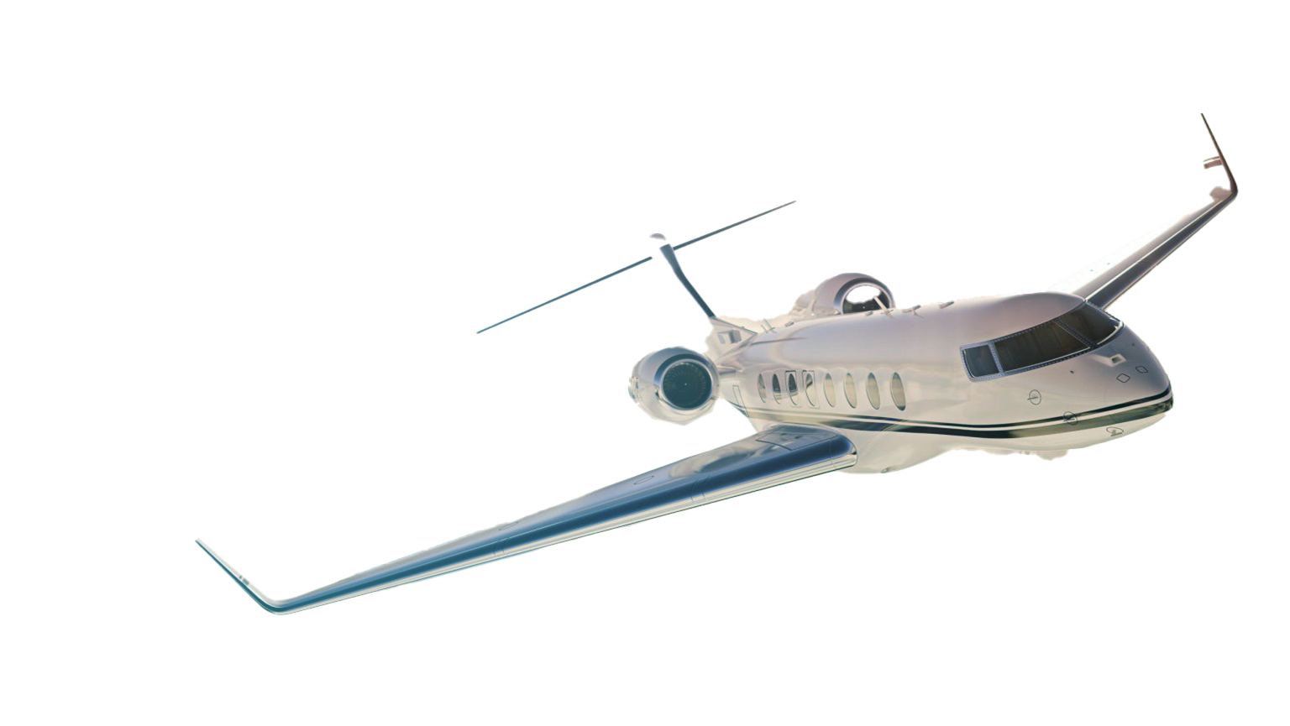
FTG CORPORATION
www.ftgcorp.com | FTG: TSX
FTG: TSX

